Slide 1
Project output
Bank Reviews – Complaints Analysis

Slide 2
Business Problem :
The Central Bank wants to analyze customers reviews and rating given by the users.
Predict Customer satisfaction with the reviews
Business Goal:
To identify the key positive and negative keywords.
Classification of reviews into Negative, Positive & Neutral
Predicting Star Ratings
Topic Clustering

Slide 3
Project Solution Approach:
Since, we have raw text data with us we have to make this data into a structured data.
For that we will follow the process of Data Pre-Processing, which includes converting the strings into lower case, removing stop words, removal of all the unwanted characters from the string for that we will use Regex, followed by tokenization.
Data Pre-Processing will give us the most frequent words, to find the positive and negative words, we can make use of Textblob.polarity and thereafter we can find the most negative and positive words.

Slide 4
Once, we obtained the Clean data, POS tagging of reviews are done, focusing on Adjectives, we can then find the polarity of the reviews and determine the reviews into positive, neutral and negative.
To predict the star rating through reviews, we will make use Logistic Regression as we have to classify the rating into 1 or 5.
For Intent Analysis we will use to discover the topic Latent Dirichlet Allocation

Slide 5
Data Pre-Processing:
Drop Date Column as it is not relevant for us.
Get reviews into a list
Convert the string into lower case by .lower() function
Replace “\n”,”\r” from the string
Use regex [^a-z] to remove everything else from the string
Use word_tokenize to tokenize the string
Remove Stop words.
Data is Cleaned and tokenized.

Slide 6
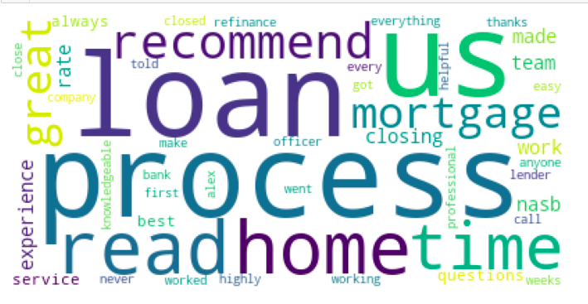
Most Frequent Words:
After getting clean list from Data-Pre-Processing, we will select the top 50 words from the list while setting the minimum criteria of 10 to shortlist the words

Slide 7
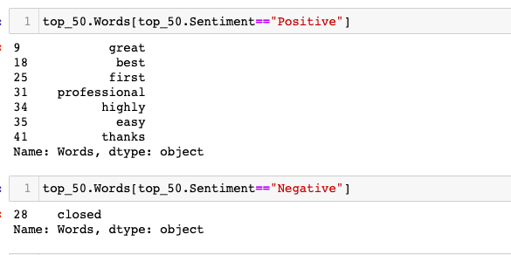
Most Frequent Positive & Negative Words:

Slide 8
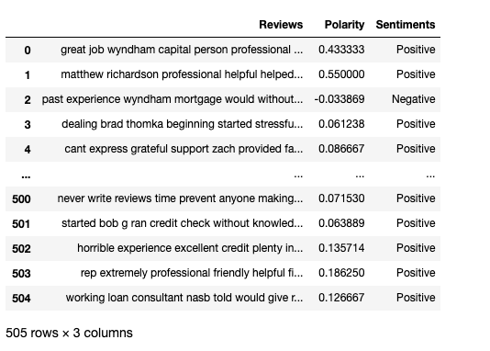
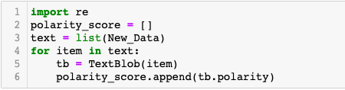
Review Classification: Positive, Negative & Neutral
With the help of textblob.polarity we will get the sentiment score between -1 to 1, where (-ve score) indicates the negative, (+ve) indicate the positive and 0 indicates Neutral.

Slide 9
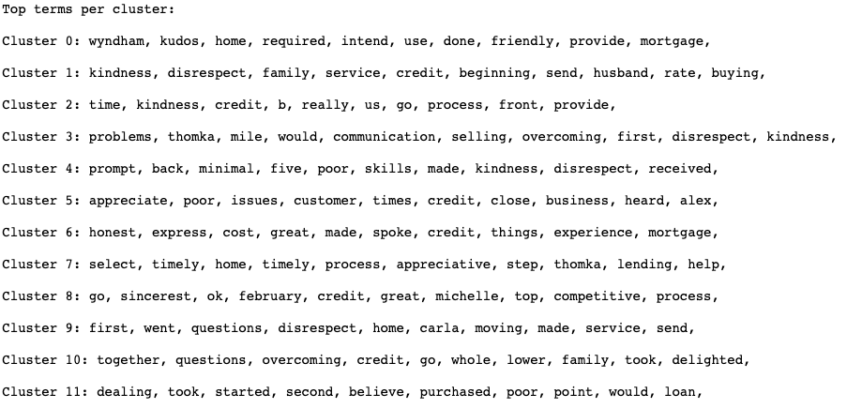
Identification of Key themes of problems:
For this we will be making use of TfidfVectorizer, K-Means and GridsearchCV to find best parameters.
Distance is calculated through cosine similarity

Slide 10
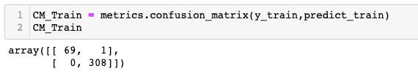
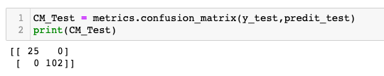
Prediction of Star Rating Using Reviews:
Star Ratings in the given data is 1 and 5, so this is a problem is of binomial classification.
Where 1 being poor rating and 5 being best rating.
For this we will use Sklearn Logistic Regression, where target variable is Ratings and X variable is Reviews
Train Data
Test Data

Slide 11
Intent Analysis
For intent Analysis we will use LDA process, Latent Dirichlet Allocation.
The unstructured data is converted into structured data with the help Simple_preprocess from Gensim.utils.
Cleaned data is then Lemmitized and POS tagging has been done
After completion of above steps data is vectorized and LDA is been applied to discover several topics.
Best Parameters are Learning Decay = 0.5, n_components = 10
Best Log Likelihood Score: -10293.022153733657
Model Perplexity: 154.1016975315418

Slide 12
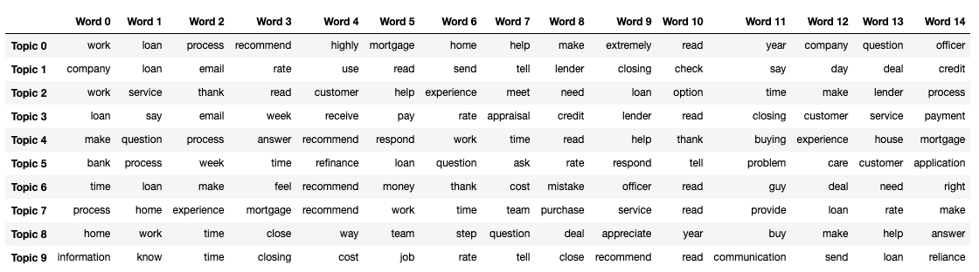
Topics Word Document

Slide 13
